Slide 1
Translating objects
Transformations

Slide 2
how to use Oak lessons

Slide 3
I can translate objects from information given in a variety of forms.

Slide 4
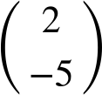
Translation is a transformation in which every point of a shape moves the same distance in the same direction.
A vector can be used to describe a translation. The vector
shows the translation 2 units right and 5 units down.
If one shape can fit exactly on top of another using rotation, reflection or translation, then the shapes are congruent.
A vertex is the point where two or more line segments meet. The plural is vertices.

Slide 5

Translating objects
Translating a single point from a description
Translating more complex objects

Slide 6
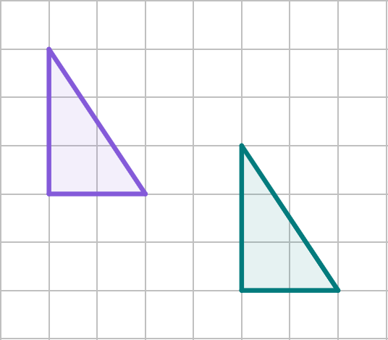
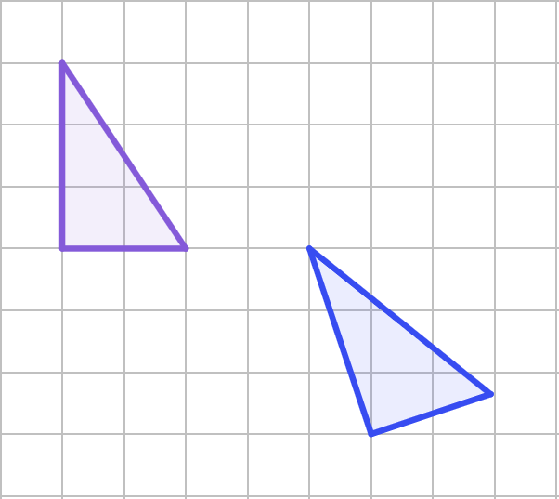
Translating a single point from a description
To translate an object or a single point, means to move it horizontally and/or vertically, maintaining orientation.
A translation
NOT a translation

Slide 7
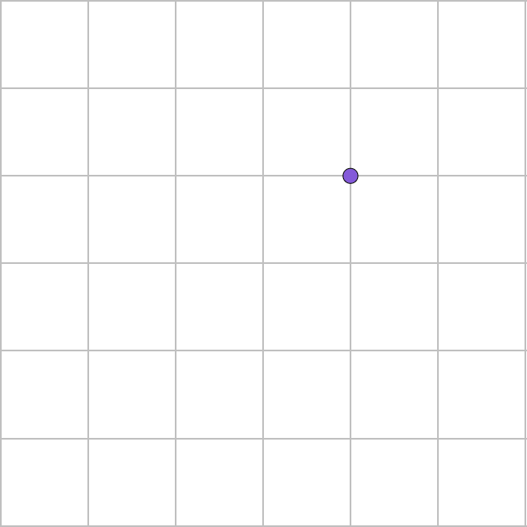
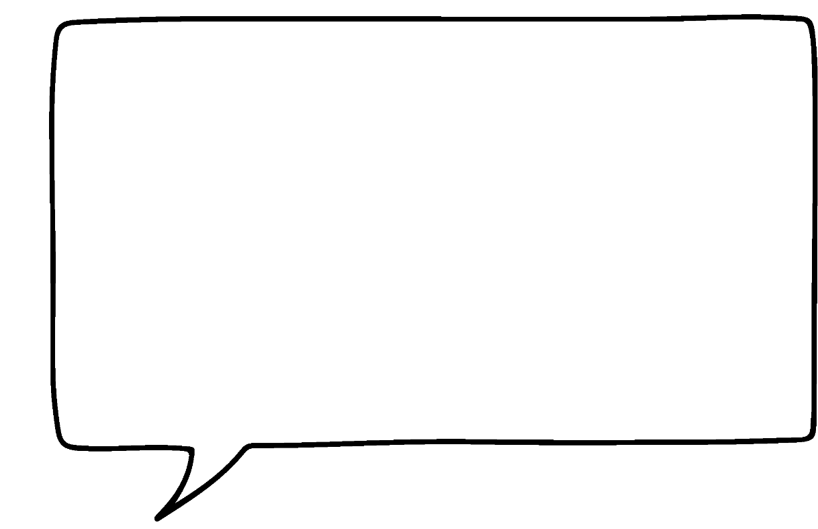
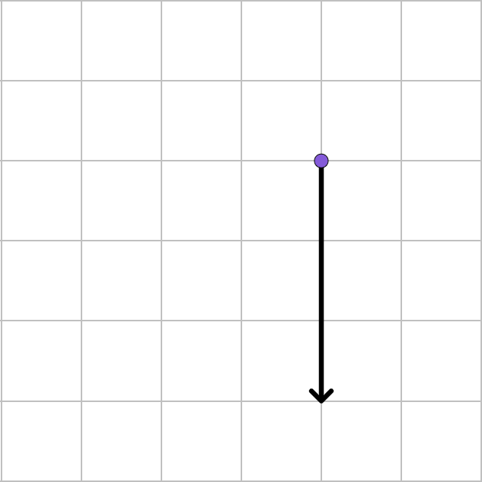
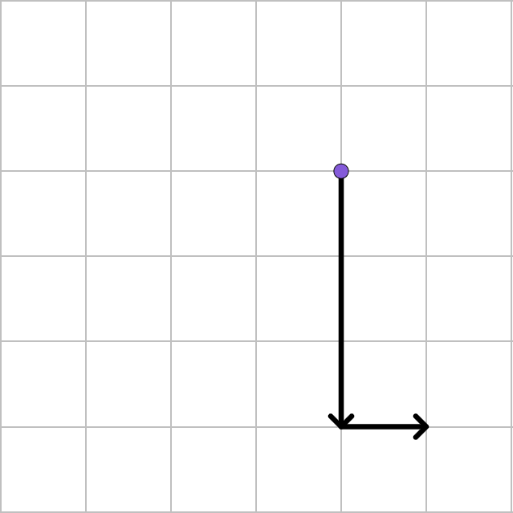
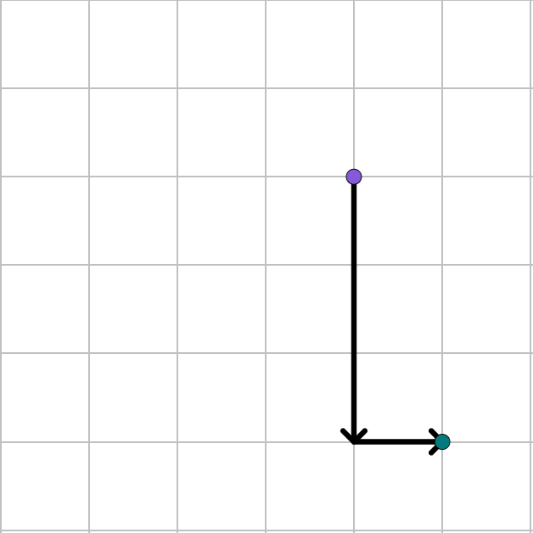

Translating a single point from a description
Translate point A down by 3 and right by 1.
If you went right by 1 and then down by 3, you would get to the same point.
A
A
A
A
A′
Sam

Slide 8

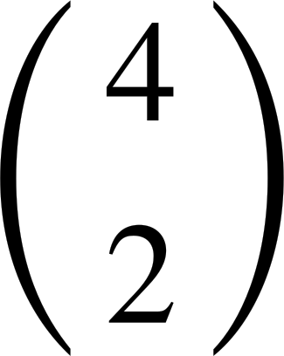
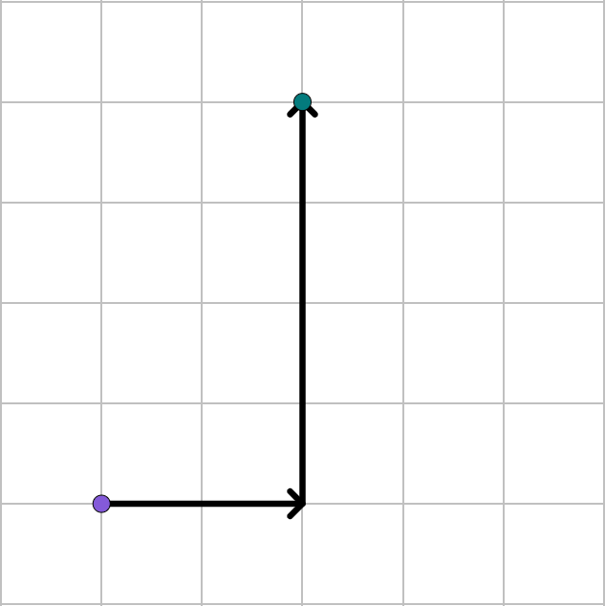
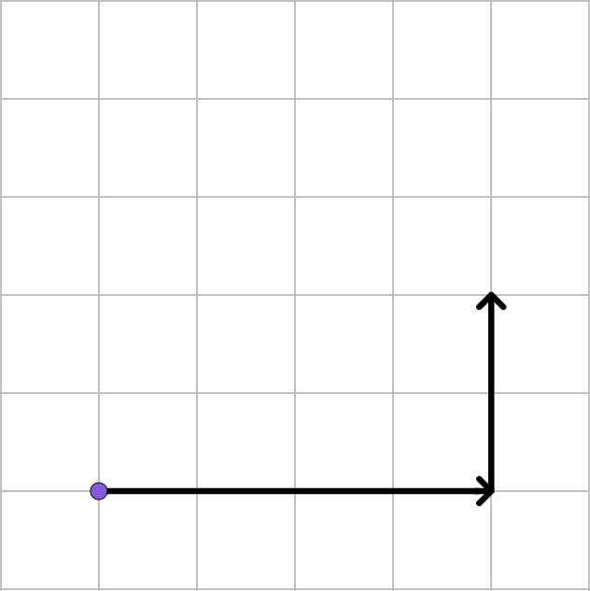
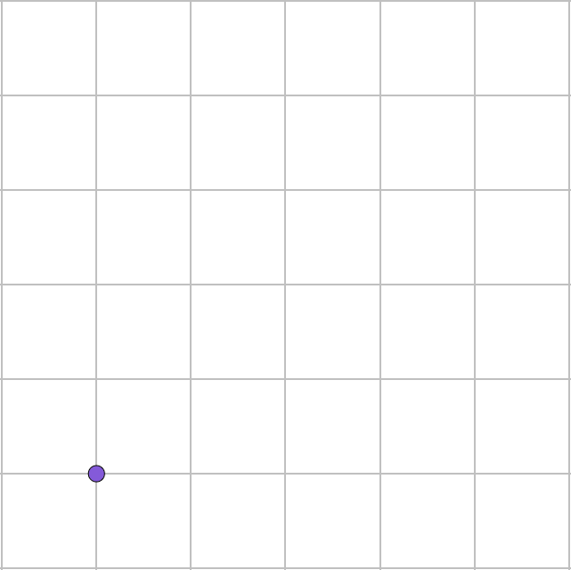
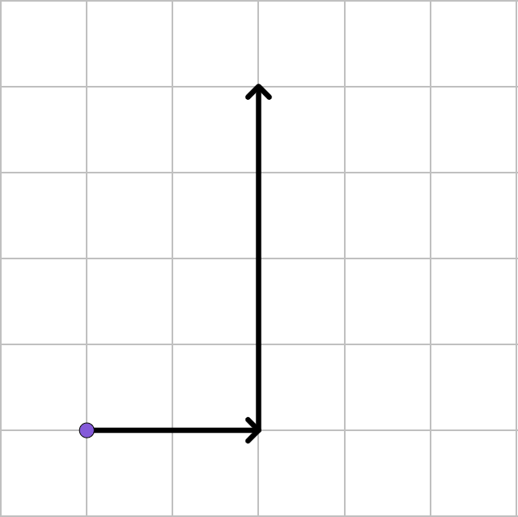
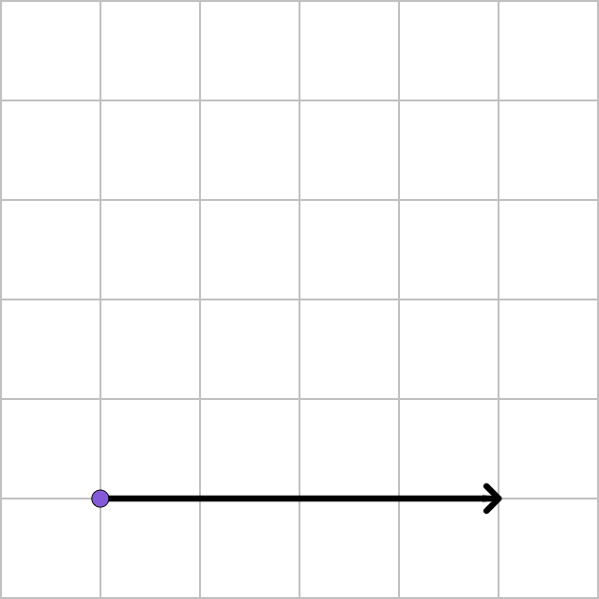
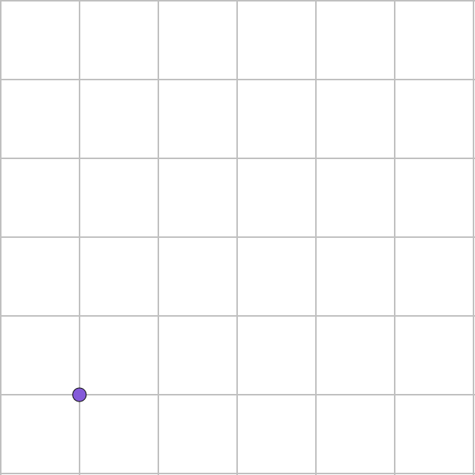
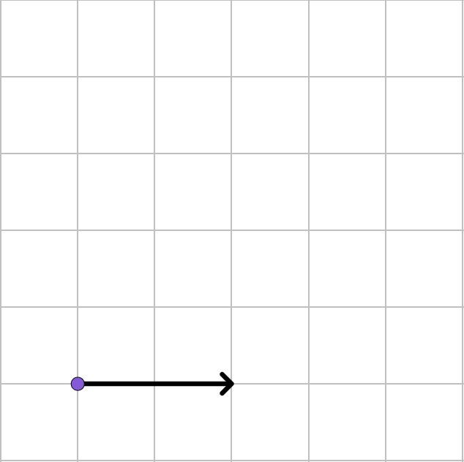
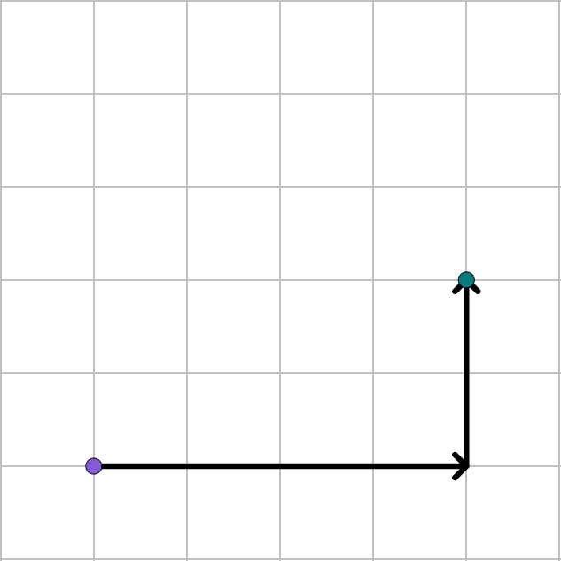
Translating a single point from a description
Translate point M by
Translate point M by
M′
M′′
M
M
M
M
M
M
M
M

Slide 9
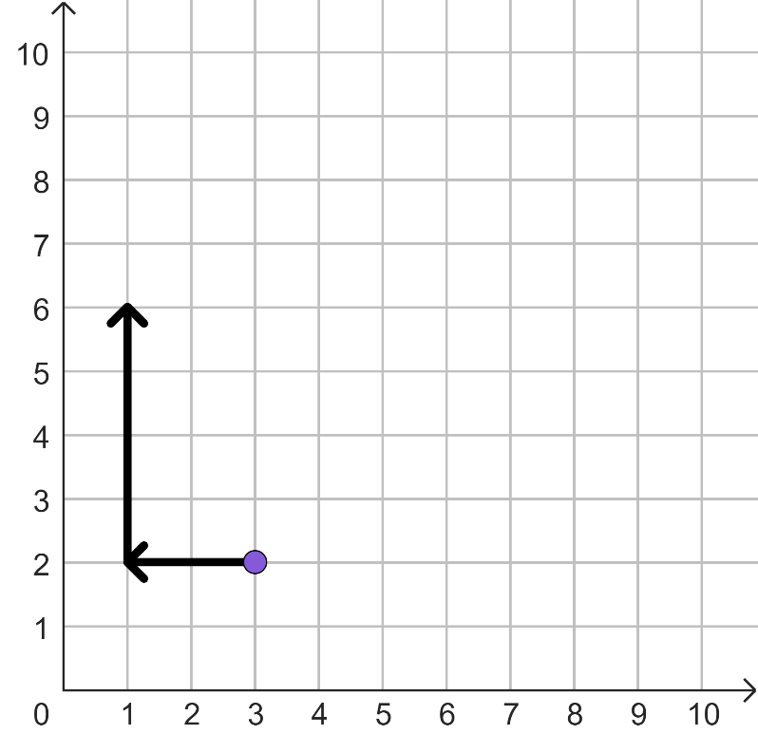
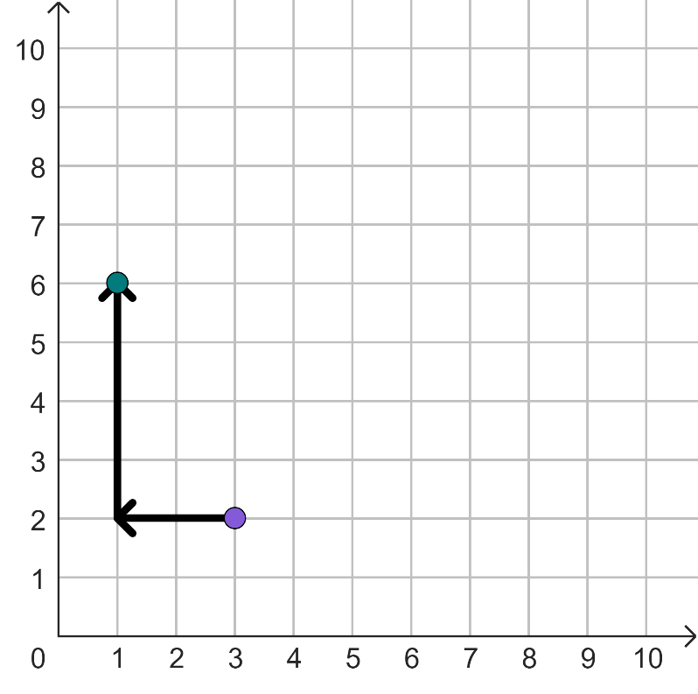
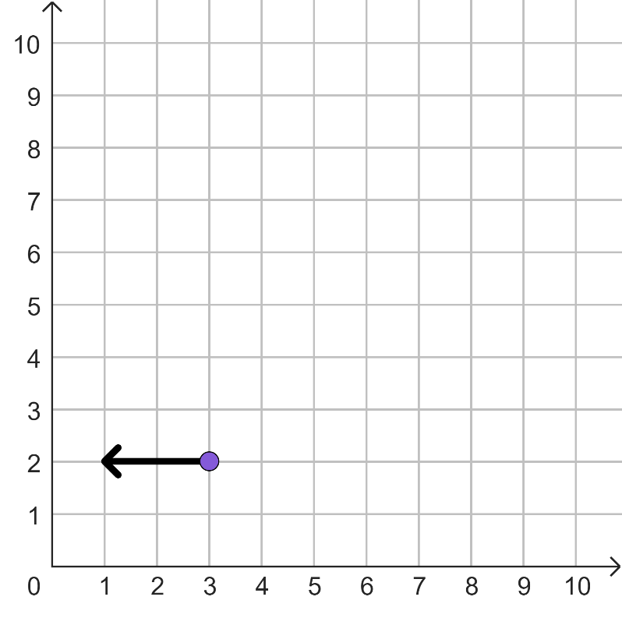
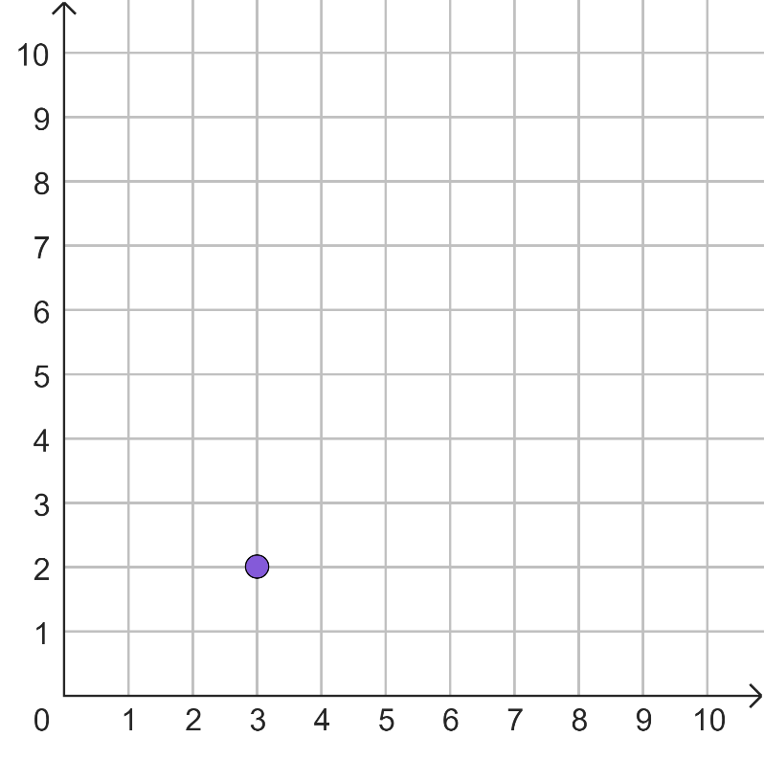
Translating a single point from a description
Translate the point (3, 2) left by 2 and up by 4.
A′
A
A
A
A

Slide 10
Translating a single point from a description
vertical
The bottom value in a column vector, tells you the displacement.
If the horizontal displacement is negative then you translate
left
.

Slide 11

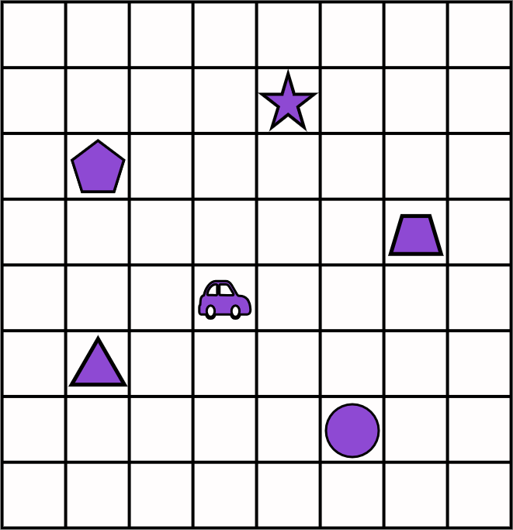
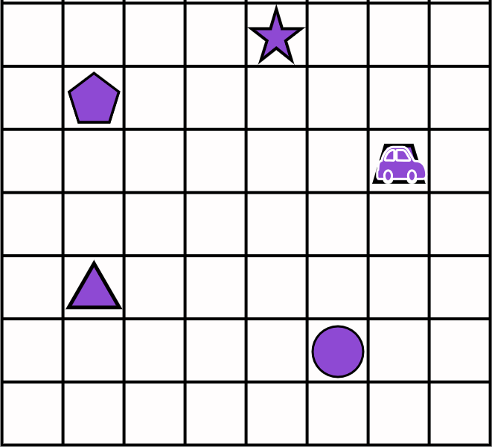
Translating a single point from a description
If the car is translated by
which shape will it land on?
On the trapezium.

Slide 12
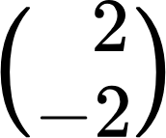
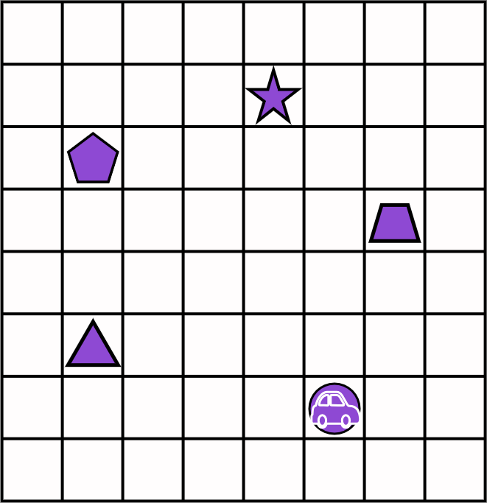
Translating a single point from a description
If the car is translated by
which shape will it land on?
On the circle.

Slide 13
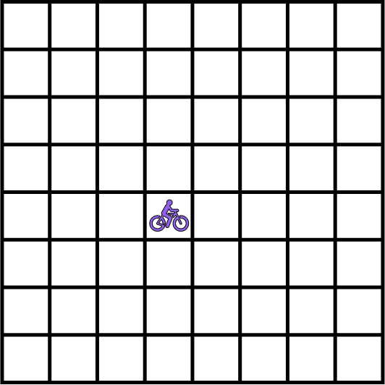
Translating a single point from a description
The bicycle is translated by
A
Where is the image of the bicycle located? A or B?
B
B, it would have moved 4 squares to the right and then 2 squares up.

Slide 14

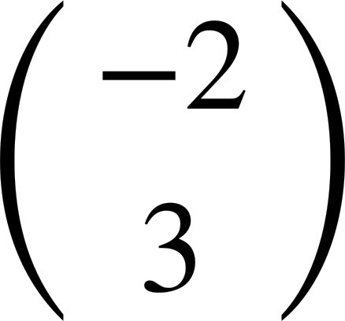
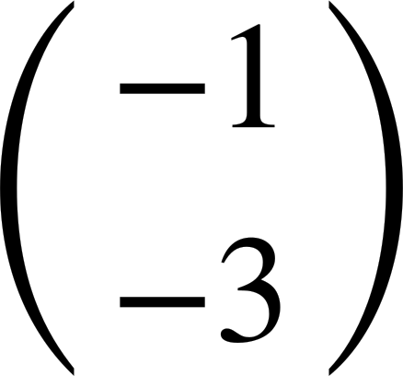
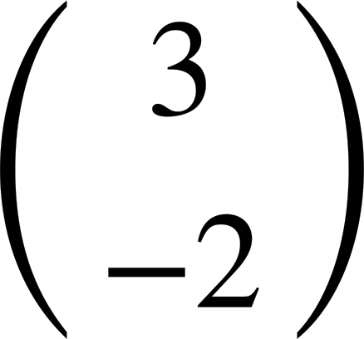
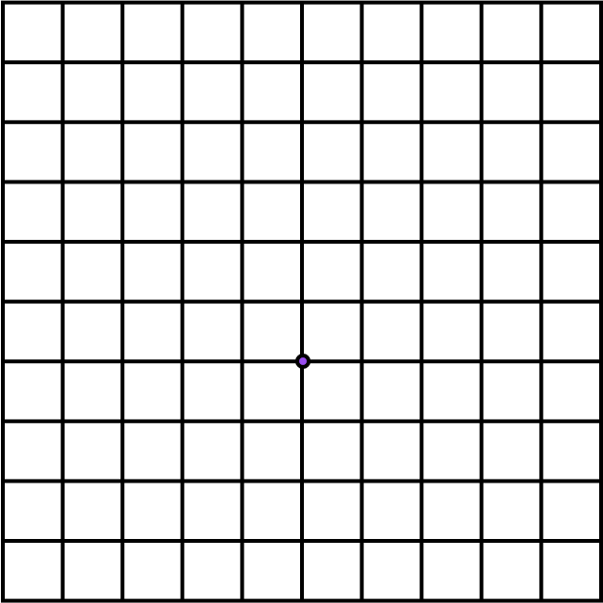
Translating a single point from a description
1) Mark the image of point L after the following translations:
.
a)
b)
c)
d)
L

Slide 15
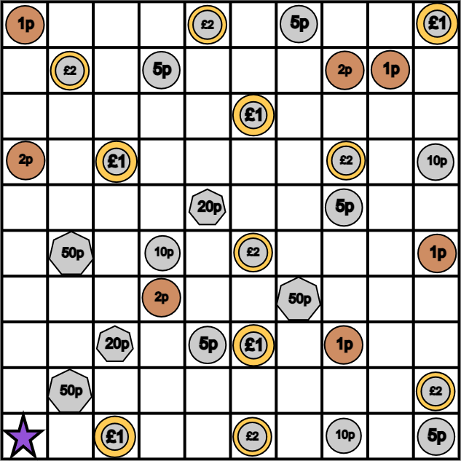
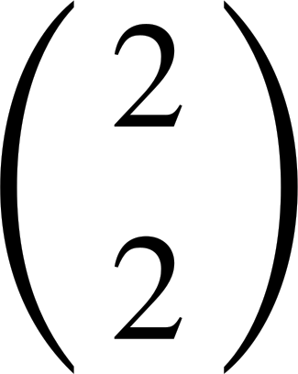
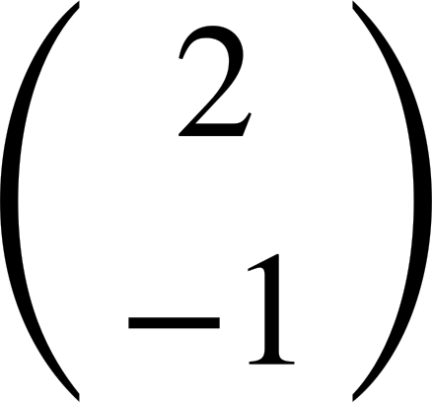
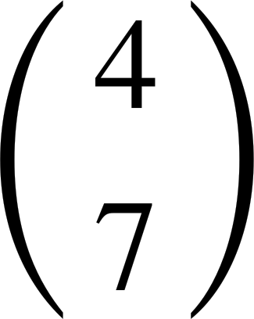
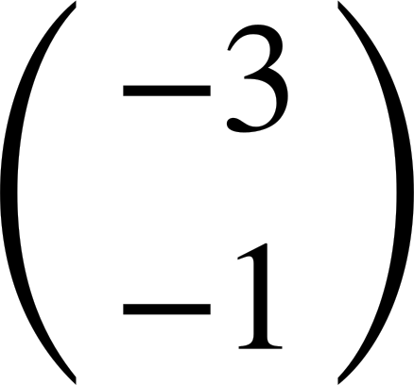
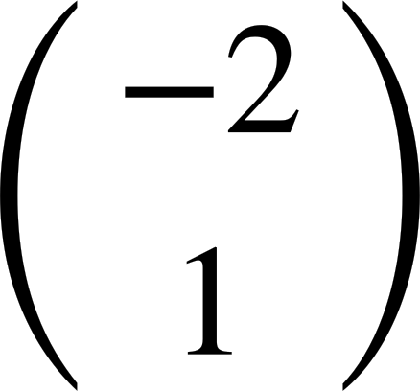
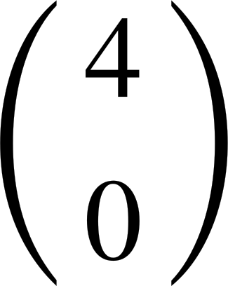
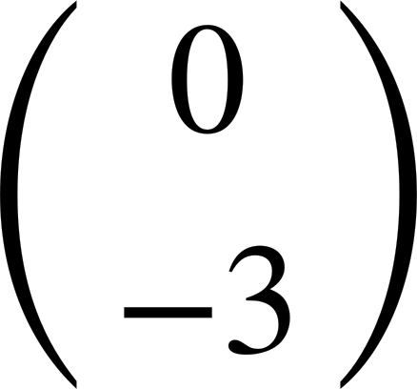
Translating a single point from a description
Work out the total money collected when following this vector trail.
Start on the star.
.

Slide 16
Translating a single point from a description
Investigate the total money you can collect using all of the vectors but in any order. Start on the star.
.
A=
B=
C=
D=
E=
F=
G=

Slide 17
Translating a single point from a description
1) Mark the image of point L after the following translations:
.
a)
b)
c)
d)
b
x
a
x
L
d
x
c
x

Slide 18
Translating a single point from a description
Work out the total money collected when following this vector trail.
Start on the star.
.
£1.33

Slide 19
Translating a single point from a description
Investigate the total money you can collect using all of the vectors but in any order. Start on the star.
.
A=
B=
C=
D=
E=
F=
G=
Some examples:
A-C-F-B-G-E-D £3.36
E-A-D-F-C-G-B 5p

Slide 20
Translating objects
Translating a single point from a description
Translating more complex objects

Slide 21
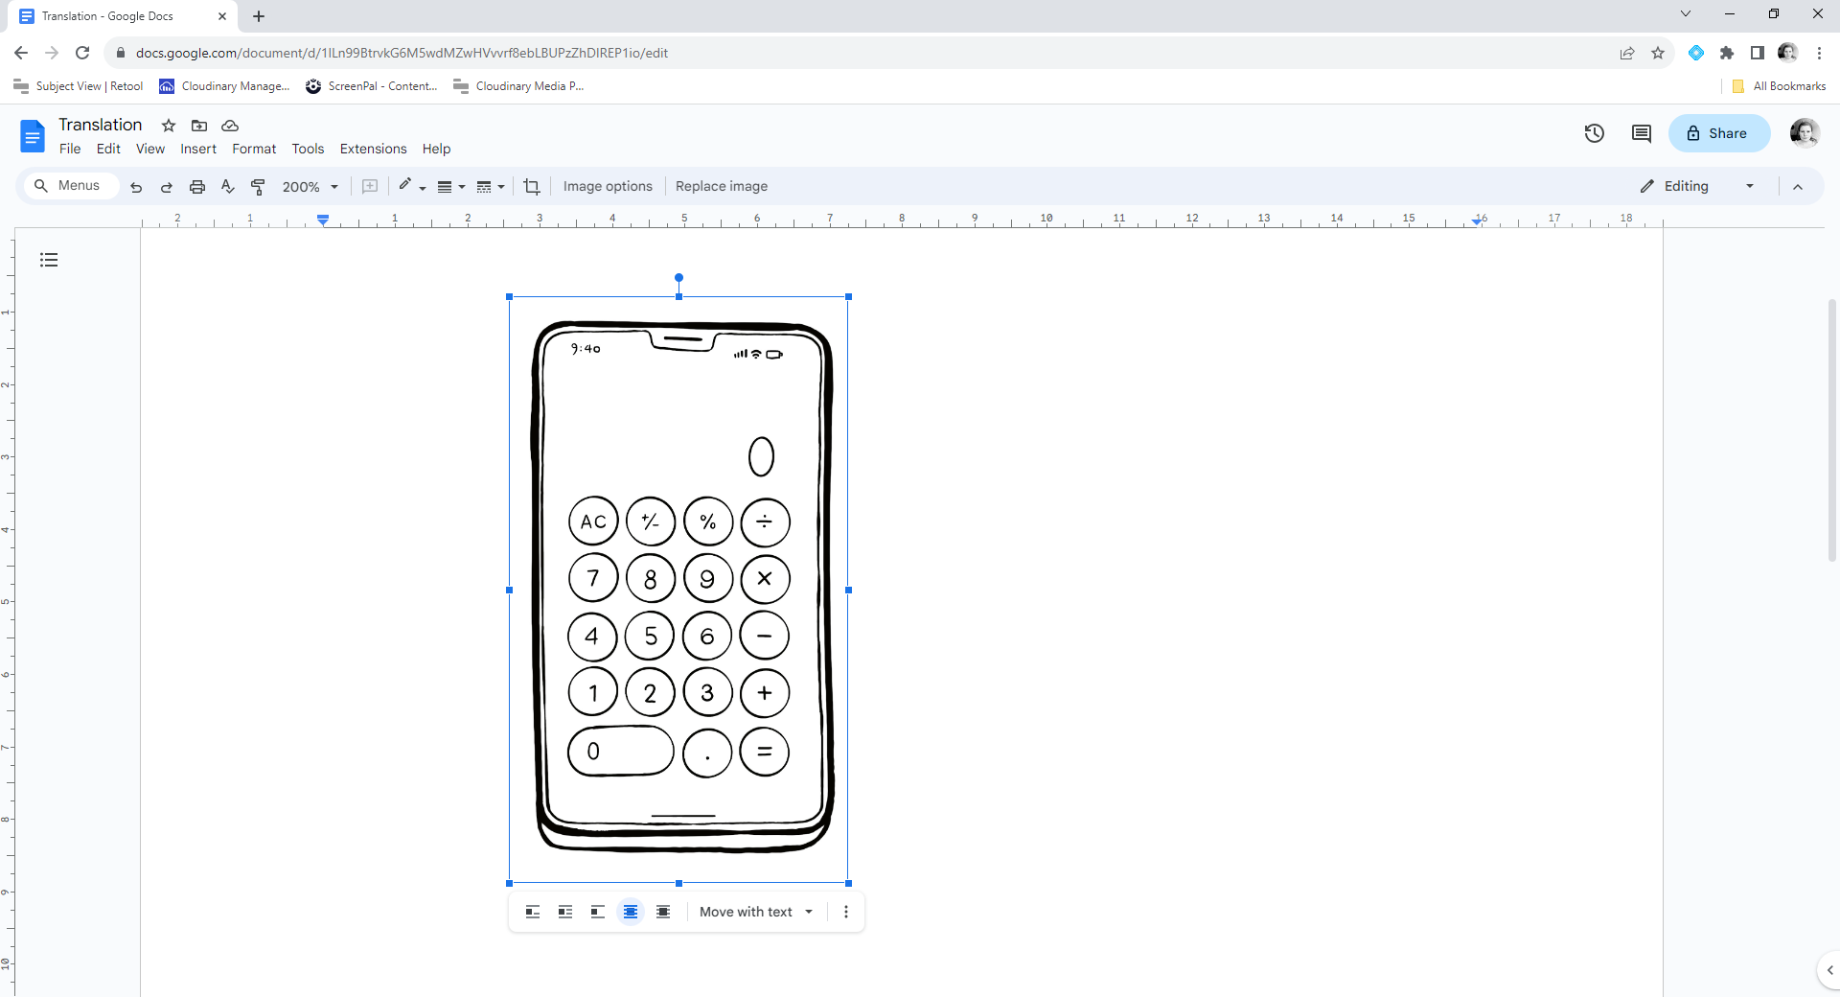
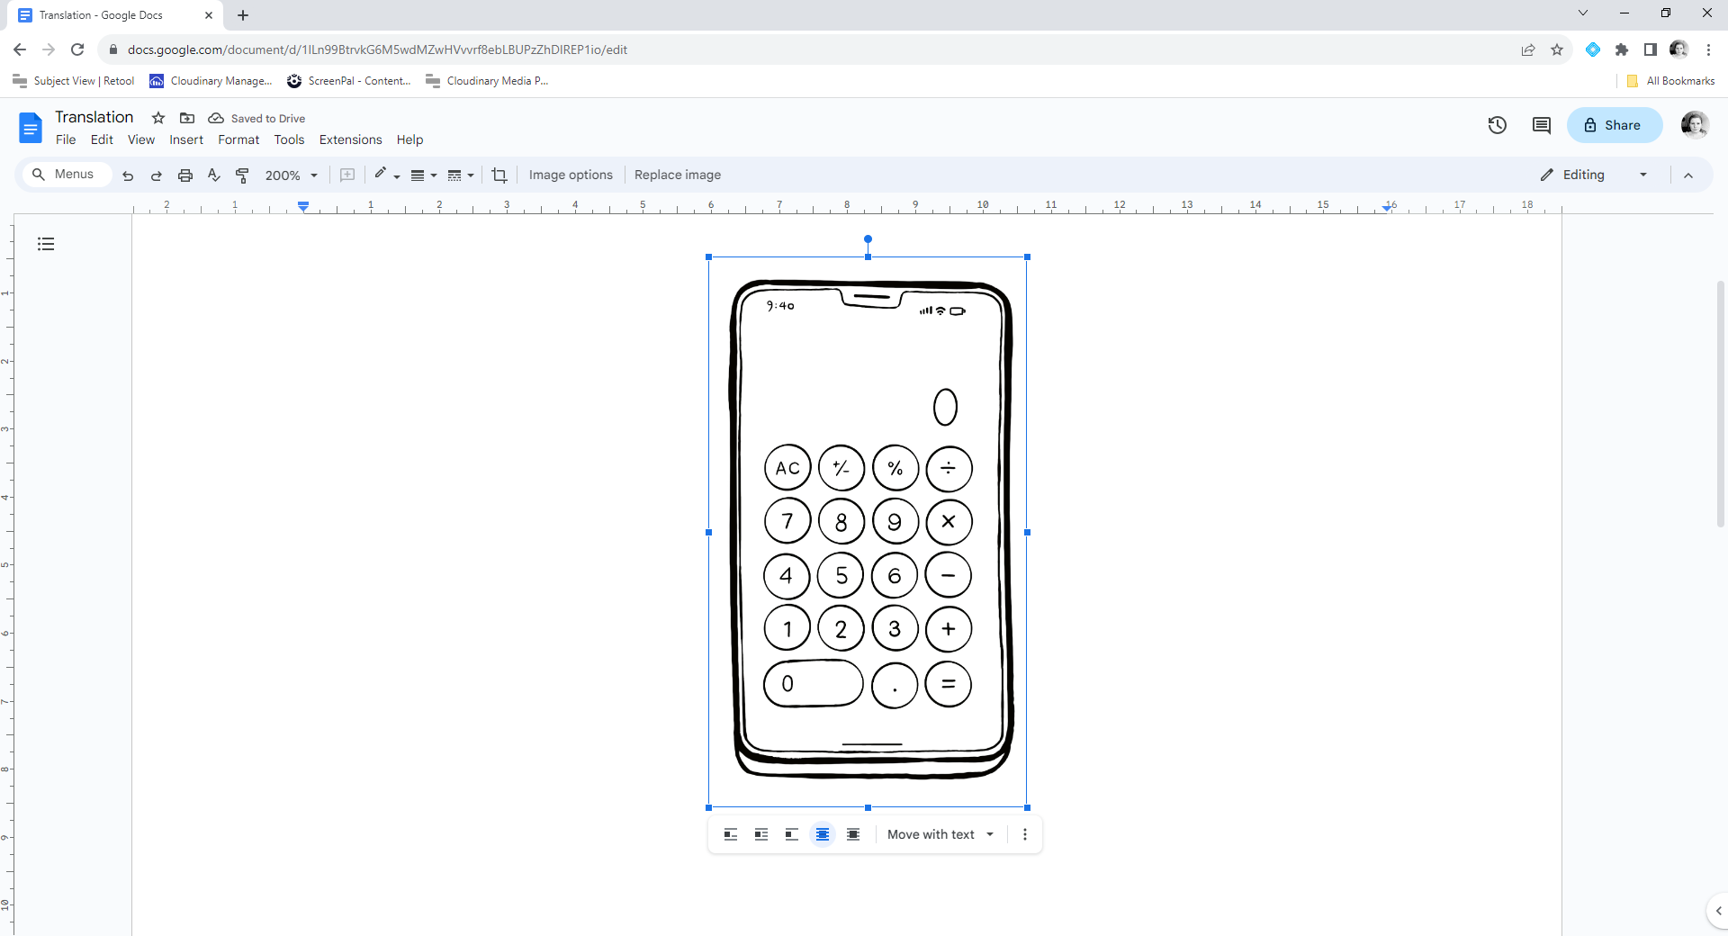
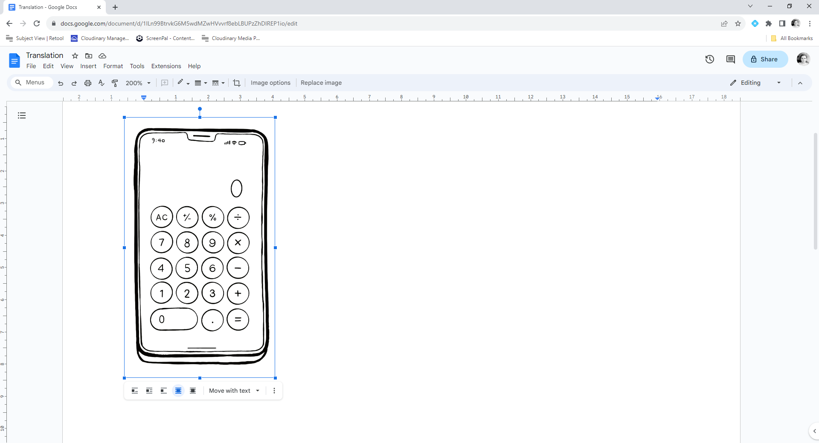
Translating more complex objects
When we use technology and drag images into different spaces, we are performing a translation. The whole image translates.

Slide 22
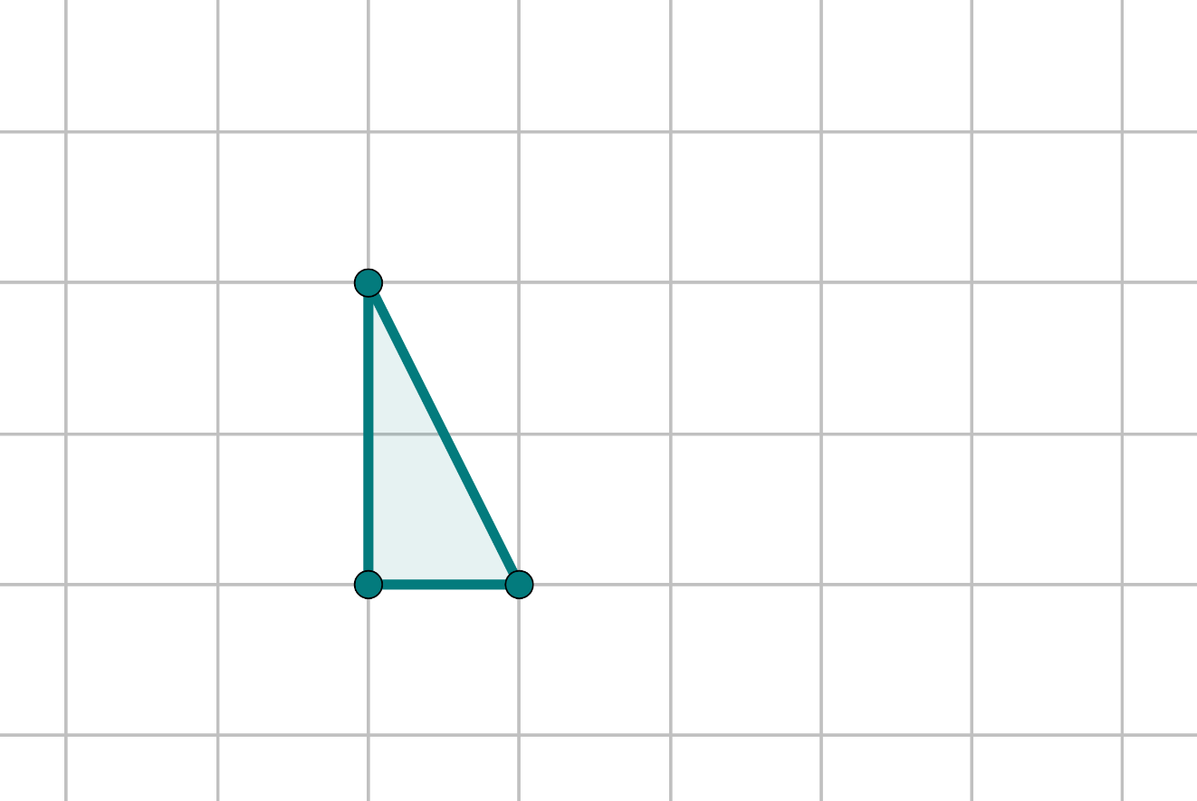
Translating more complex objects
If we use tracing paper we can replicate the idea of translating the whole object.

Slide 23
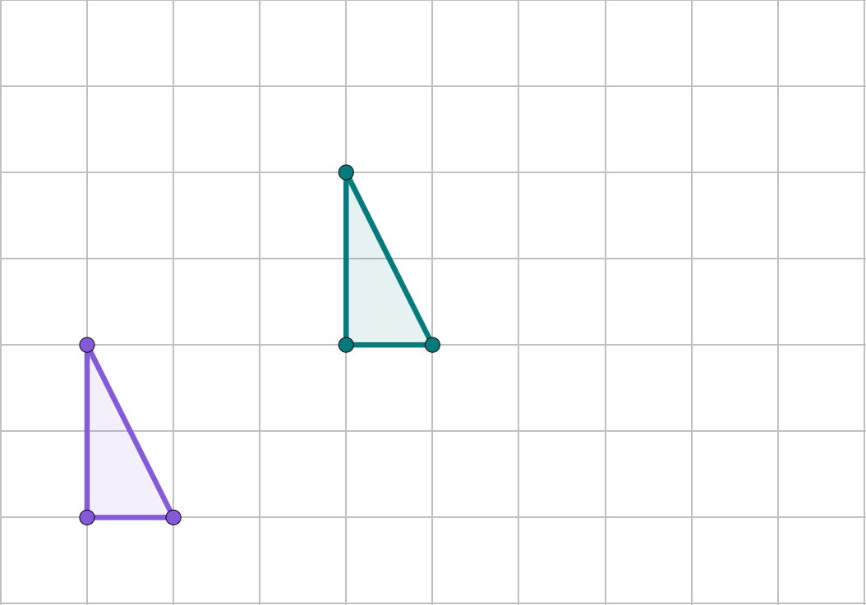
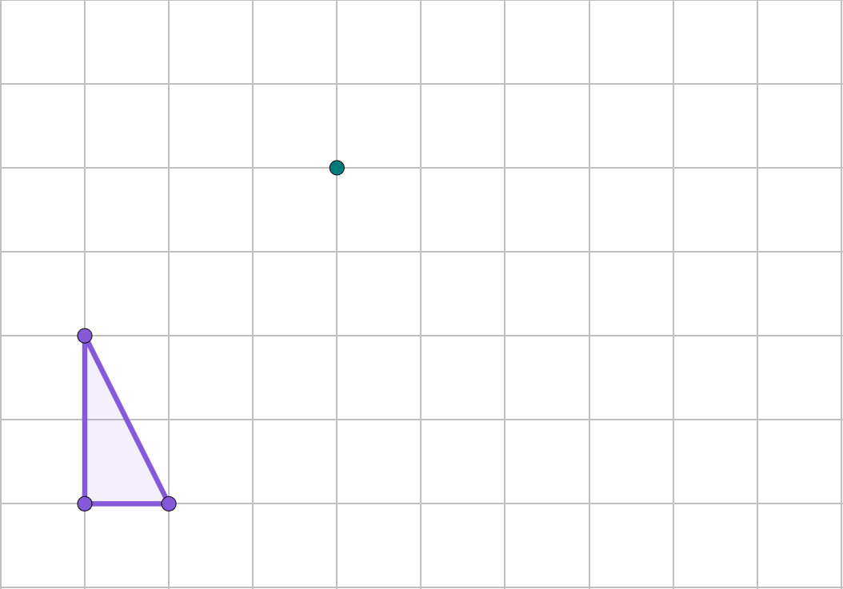
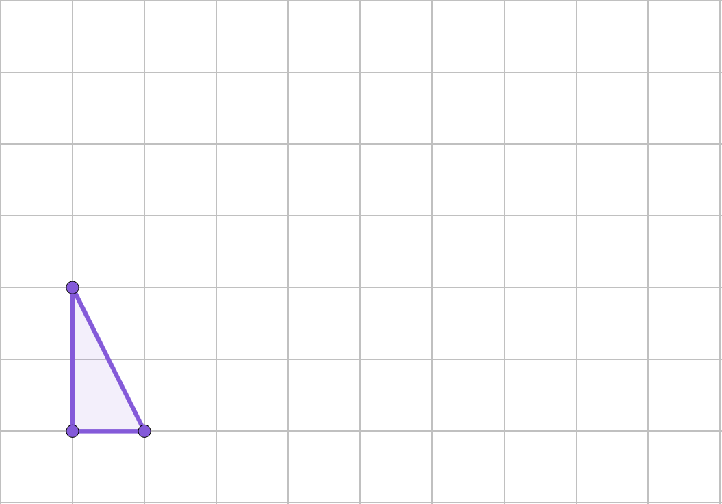
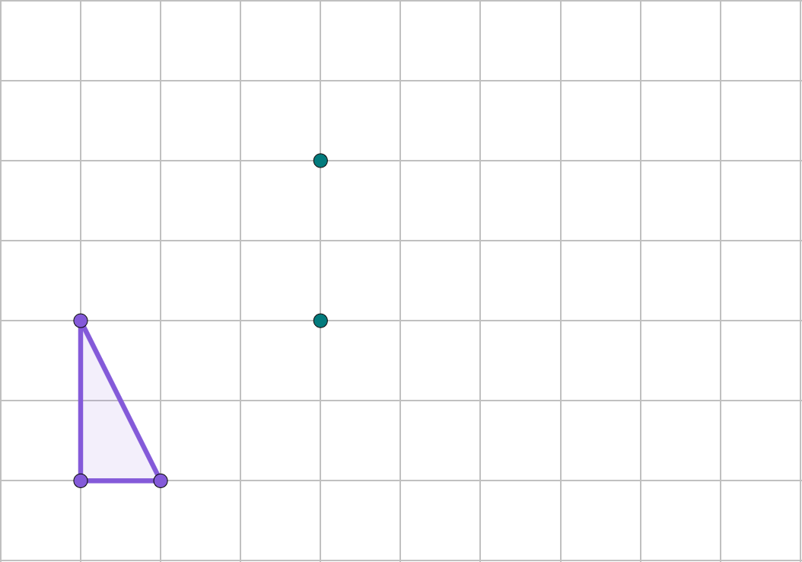
Translating more complex objects
As before, we can consider the vertices of a shape and translate them one by one.
X′
X′
X′
X
X
X
X
Y′
Y′
Z′
Z
Z
Y
Z
Y
Z
Y
Y

Slide 24
Translating more complex objects
Alternatively, we could translate one vertex and draw in the remaining parts of the image.
X′
X′
X
X
Y′
Z′
Y
Z
Y
Z

Slide 25
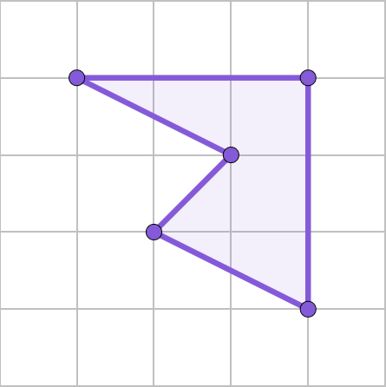
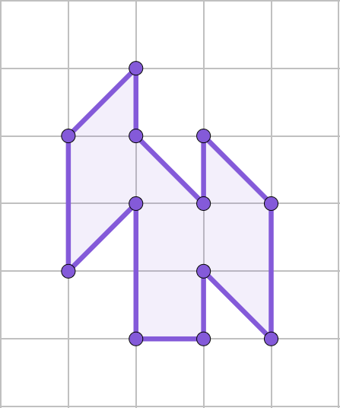
Translating more complex objects
Sometimes the complexity of the object may support one of the methods more than the other.
Which method might you use for each of these?

Slide 26
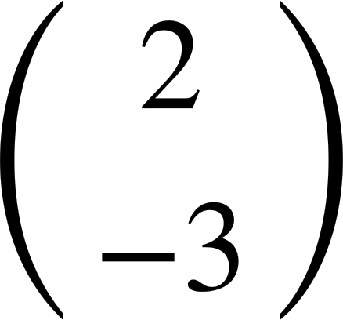
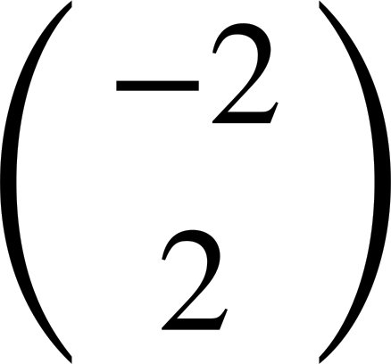














Translating more complex objects
Translate the object by
Translate the object by
E
D
D′
A′
A
F
C′
B
D
E′
D′
B′
A
C
A′
F′
C
B′
B
C′

Slide 27


Translating more complex objects
Here is a plan view of a bedroom. By only translating the objects, redesign the layout.
drawers
bed
desk
wardrobe

Slide 28




Translating more complex objects
Complete the translations, always start with triangle A.
a)
b)
c)
d)
A
e)
f)

Slide 29

Translating more complex objects
Here is a plan view of a bedroom. By only translating the objects, redesign the layout.
Here is an example.
The pink corner wardrobe cannot move anywhere else, if it is to remain touching two walls.

Slide 30

Translating more complex objects
Translate triangle A by the following vectors:
d
a)
b)
a
c)
d)
A
e
c
b
e)
f)
f

Slide 31
Translating objects
You can choose one vertex of the object and translate that point, before drawing in the rest of the image.
You can translate each vertex of the object, to form the image.
The image will always be congruent to the object after a translation.

Slide 32

© Oak National Academy 2023.
Produced in partnership with Mathematics in Education and Industry.
Licensed on the Open Government Licence v3.0, except where otherwise stated. See Oak terms and conditions.

